Slide 1

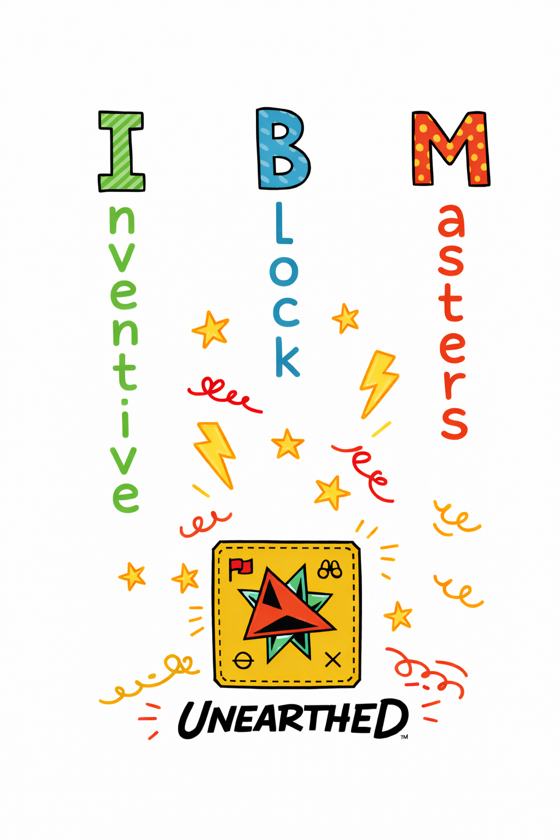

Slide 2
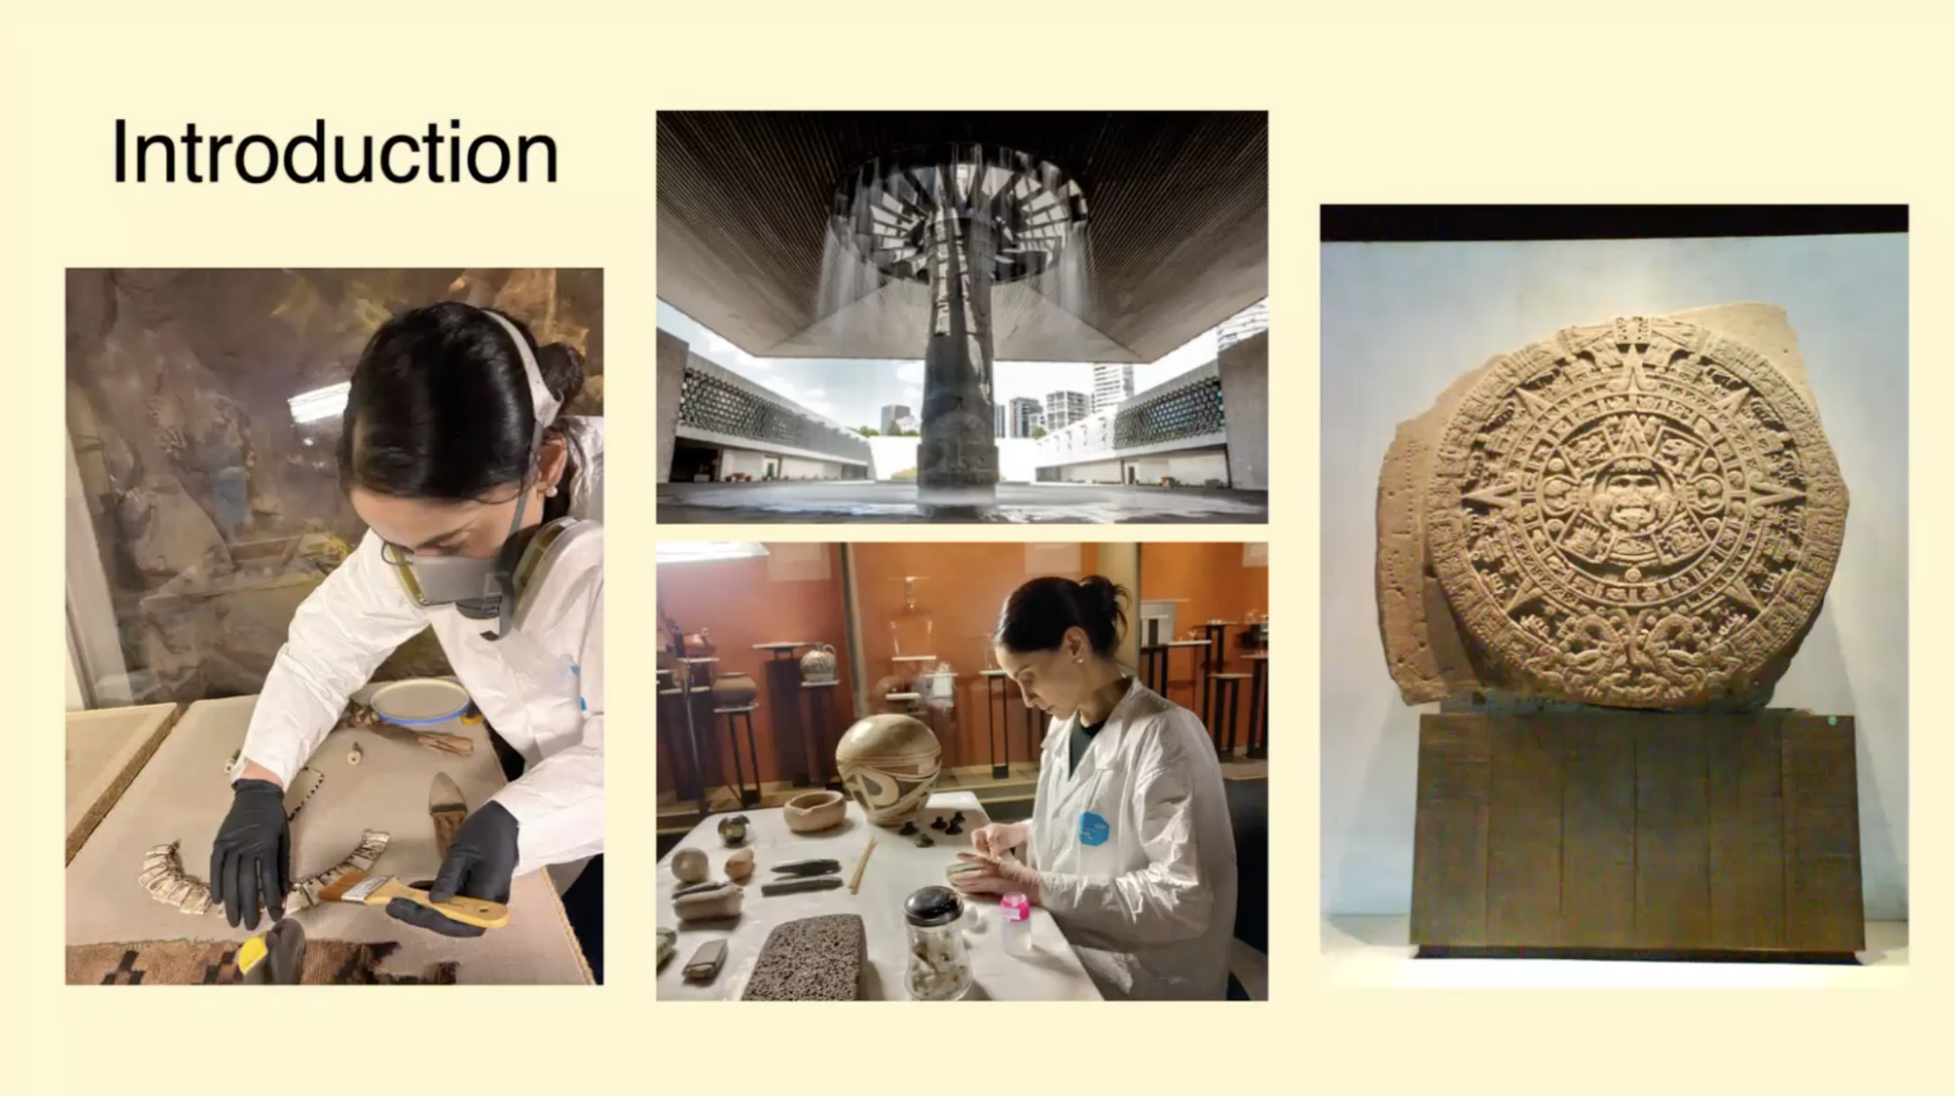
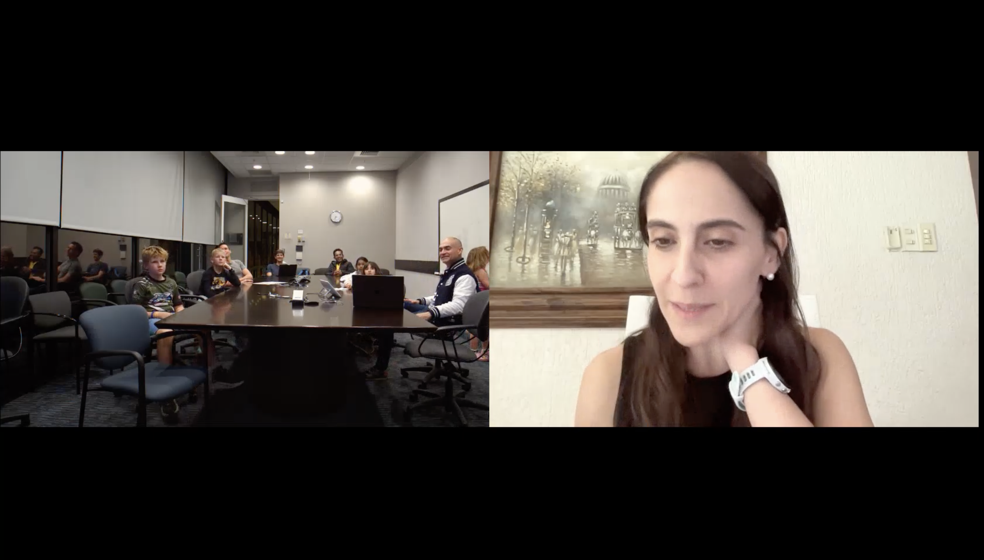
Mariana Diaz de Leon
Expert at the National Museum of Anthropology
Mexico City

Slide 3
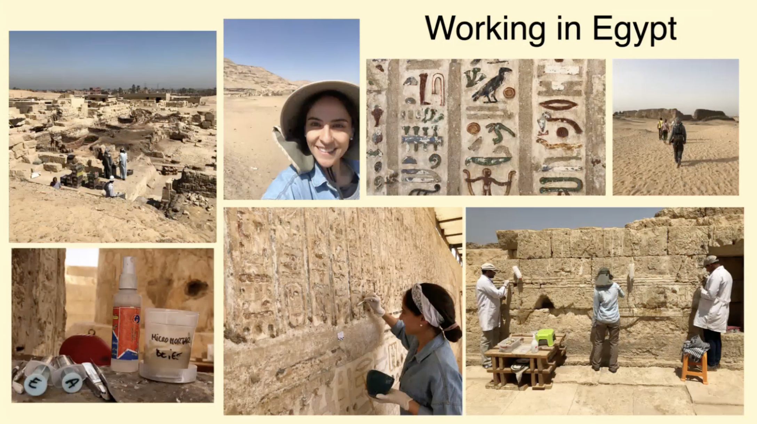
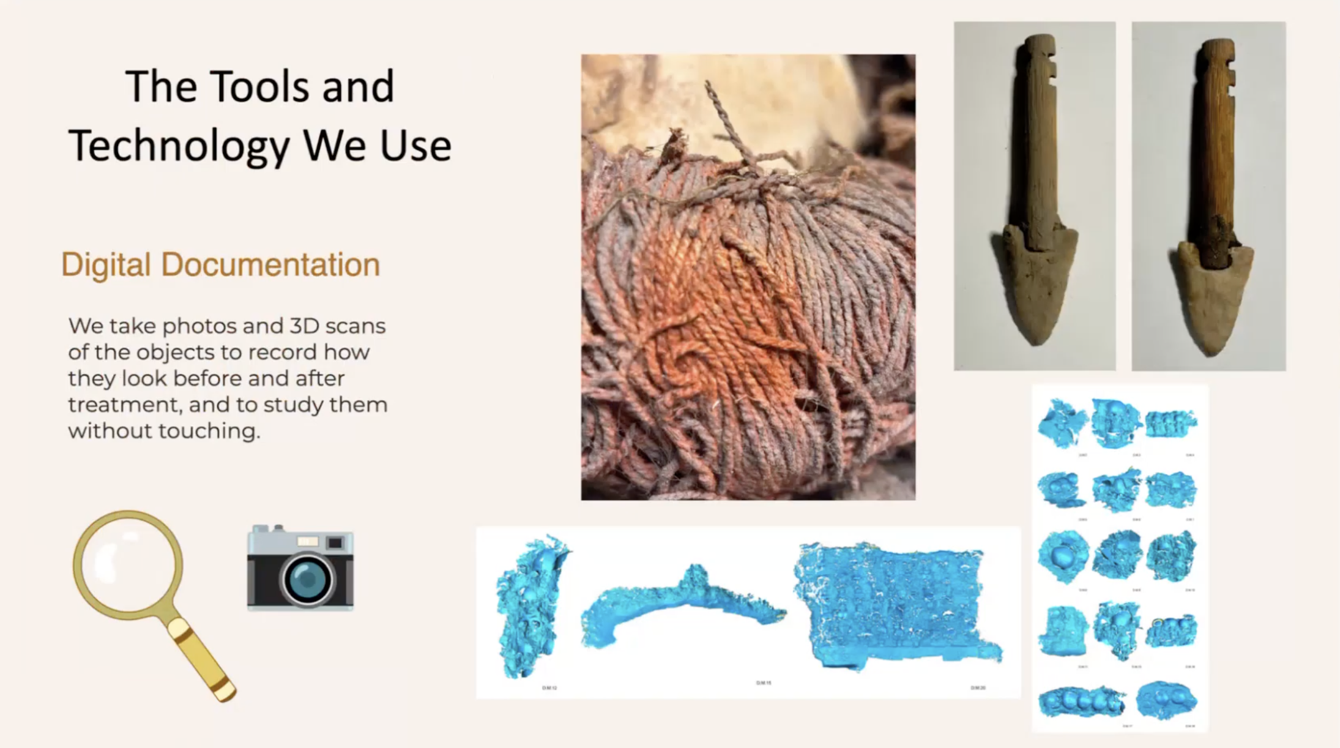

Slide 4
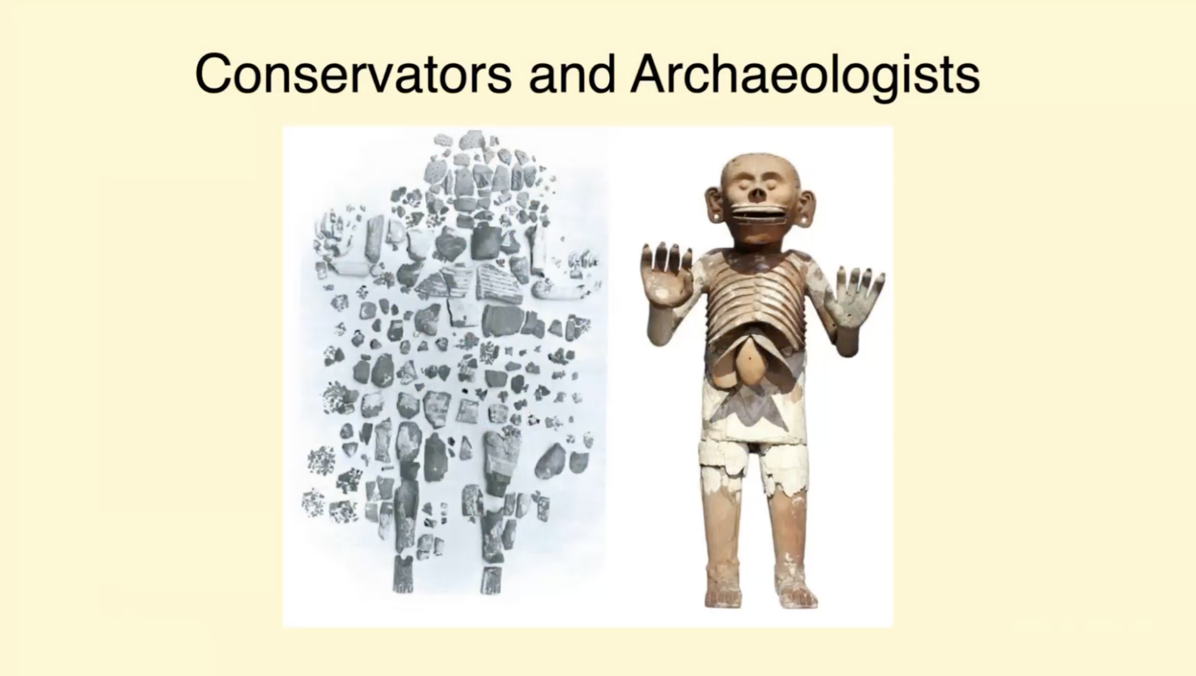

Slide 5
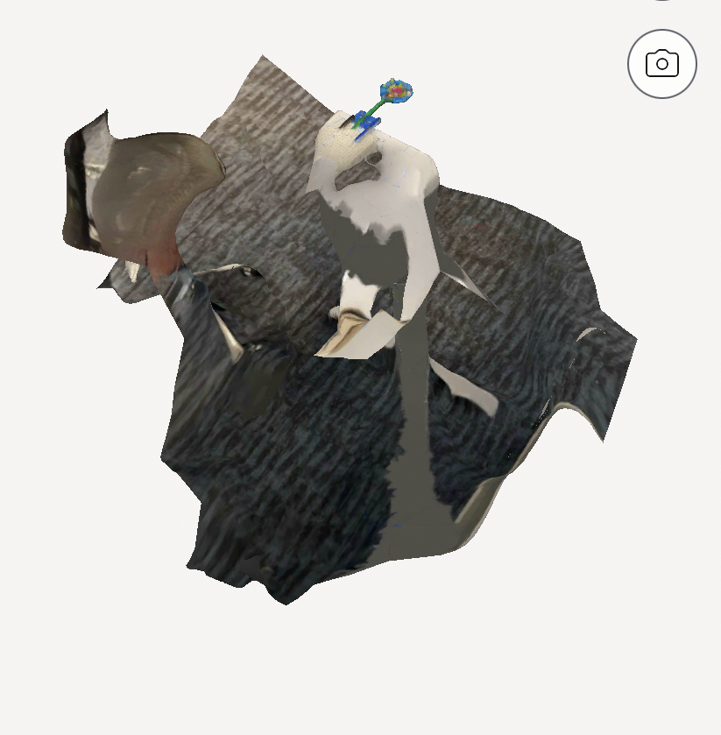
If we moved too much, we got bad results!!!

Slide 6
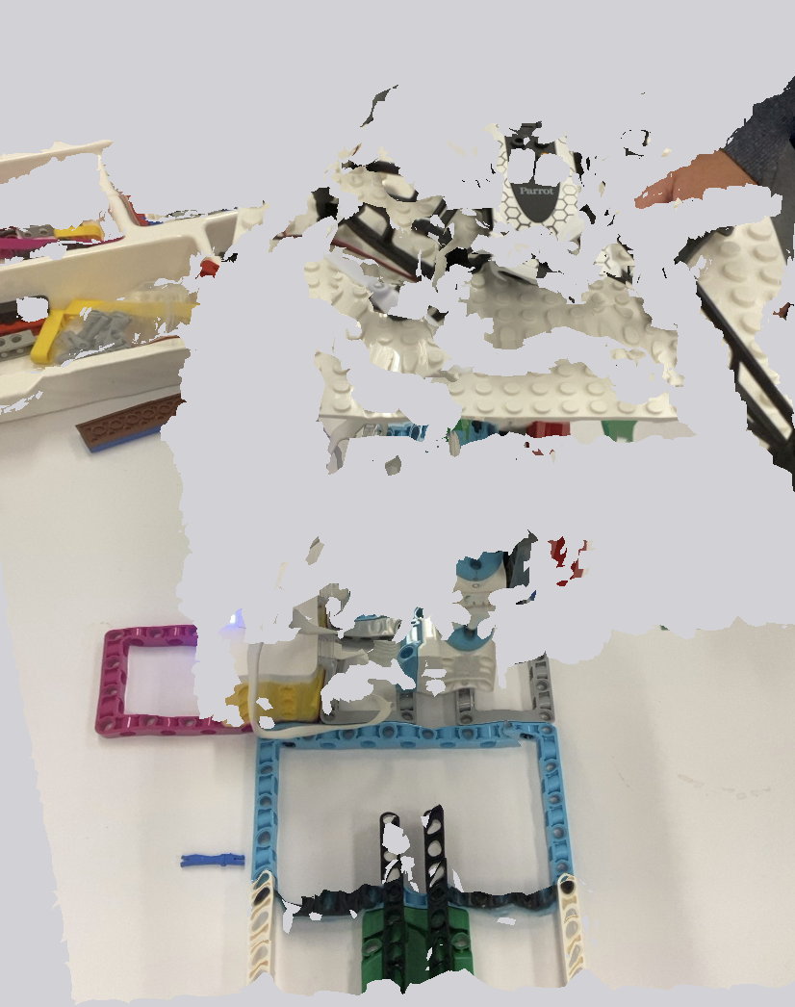
We were scanning not the object but the outside as well!!!

Slide 7
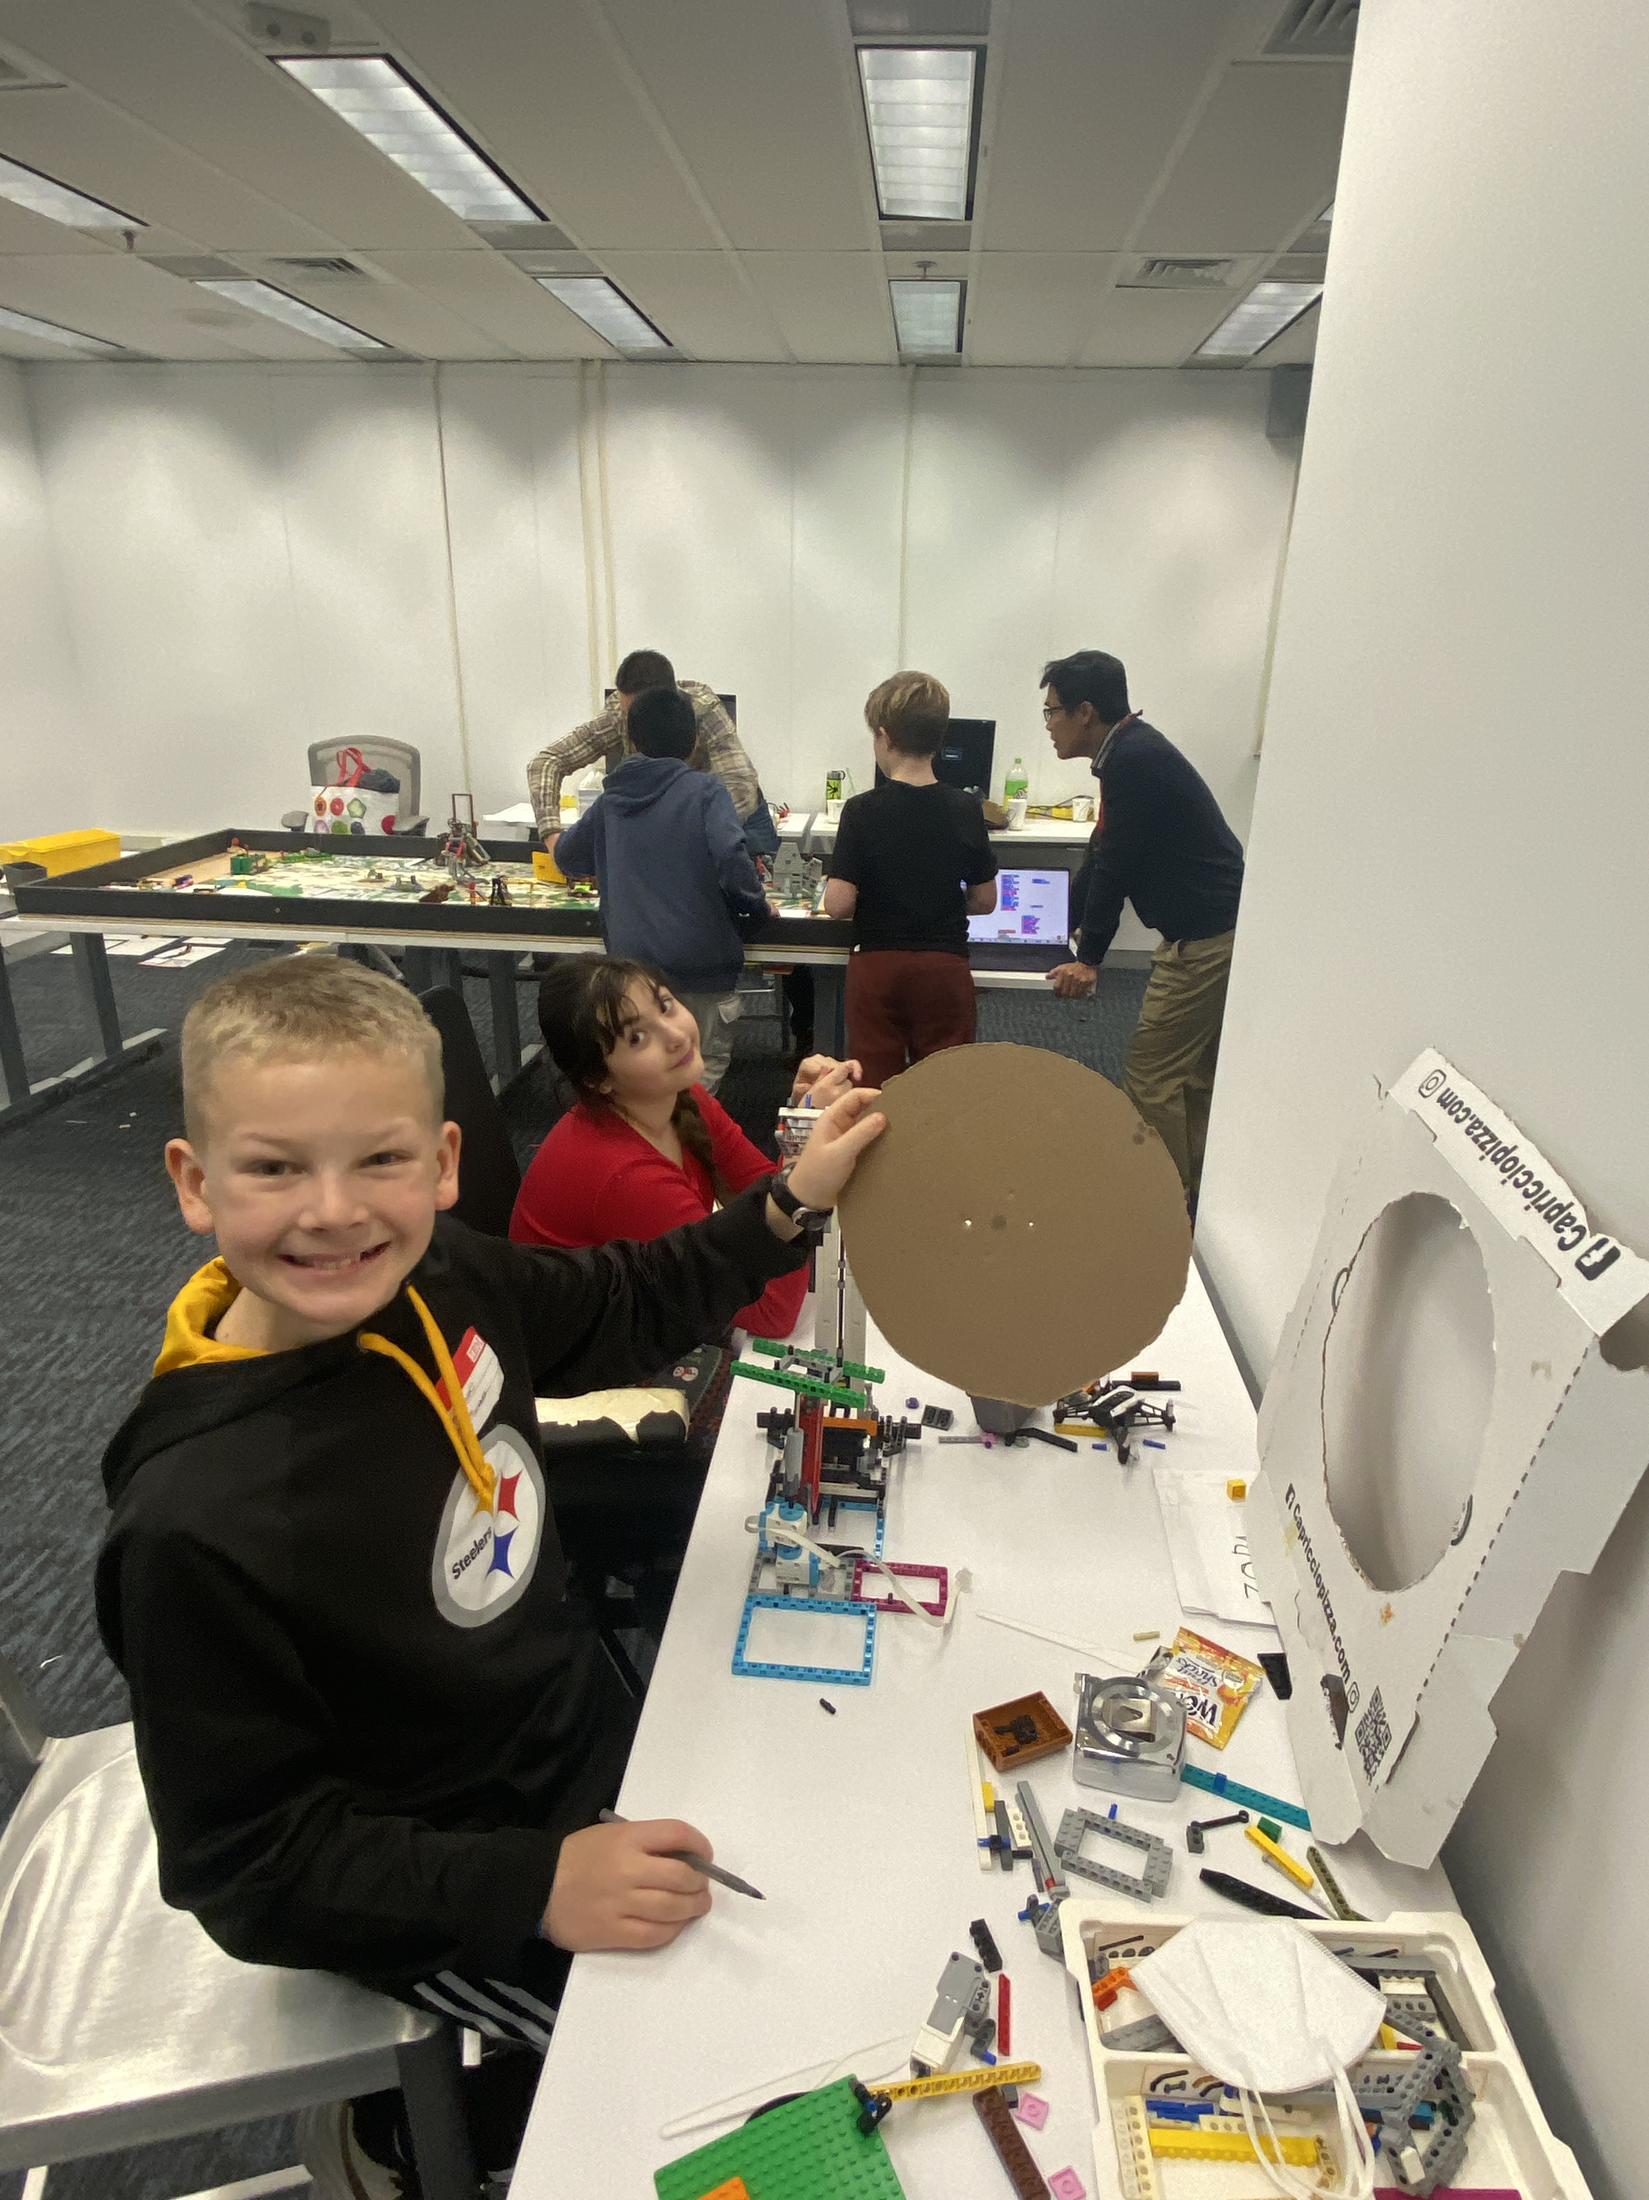

Slide 8
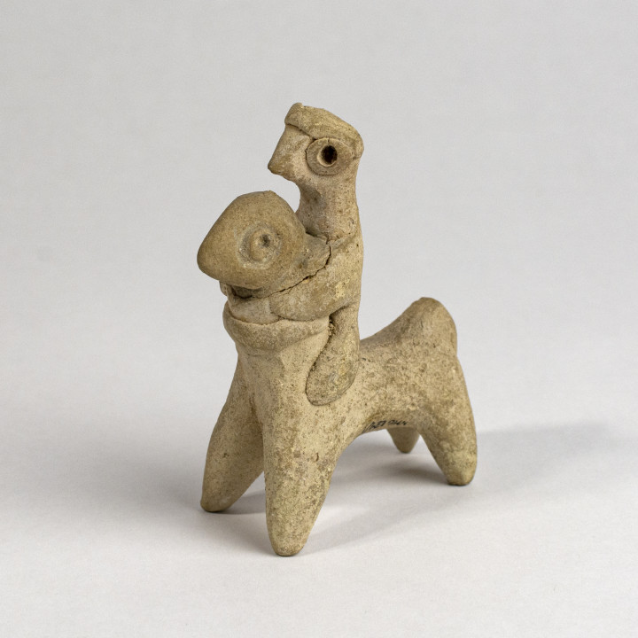
Material: Clay. Accession no.: MG 139/001. Current location: The Hunt Museum, Limerick.
A stylized figure of a horse and rider. The arms of the rider are around the neck of the horse. Middle Eastern, Hittite.
(old Turkey)

